Slide 1

Be Genuine
Malachi
Dr. Rick Griffith • Crossroads International Church Singapore
BibleStudyDownloads.org

Slide 2
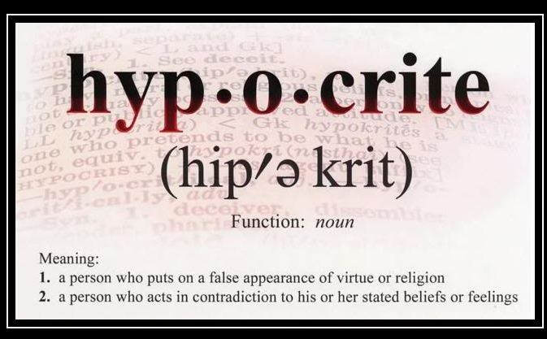
If you don't walk the talk, it's probably best not to talk the talk
Meaning:
a person who puts on a false appearance of virtue or religion
a person who acts in contradiction to his or her stated beliefs or feelings
Notes:
It’s great to see you here at church today. But why have others not joined us?
• Ask why a person doesn’t go to church, and you’ll soon get the response: “The church is just full of hypocrites.”
• As one person says, “If you don’t walk the talk, it’s probably best not to talk the talk.”

Slide 3
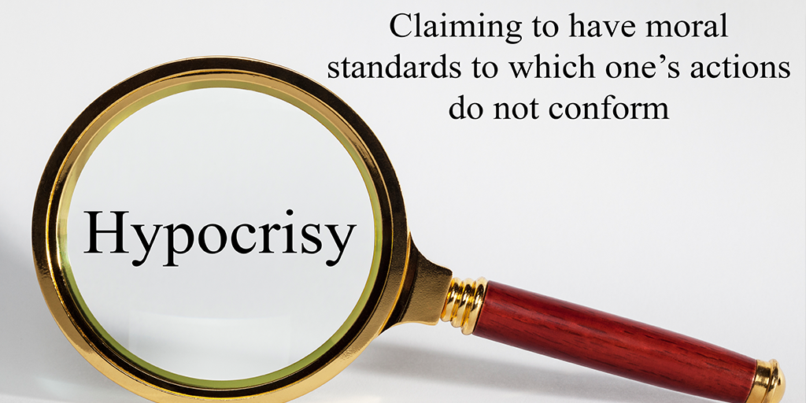
Hypocrisy
Claiming to have moral standards to which one’s actions do not conform
Notes:
In a sense, that is admirable. Hypocrisy is claiming to have moral standards to which one’s actions do not conform. We should be authentic, right?

Slide 4
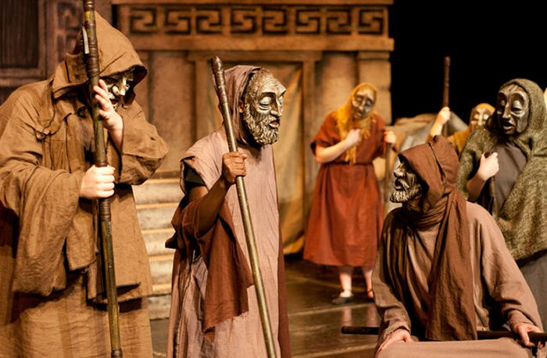
Hypocrites (Greek stage term)
Notes:
"In the context of Gr. Drama the term hypocrite was applied to an actor on the theater stage. Since an actor pretends to be someone other than himself, hypocrites was applied metaphorically to a person who ‘acts a part’ in real life, pretending to be better than he actually is, one who simulates goodness. In secular Gr. Literature, therefore, hypocrites may be either neutral or undesirable. In the NT, however, it is always undesirable, signifying one who works a deception by feigned piety."
http://www.bibleone.net/print_es3.html, accessed 23 July 2017.

Slide 5
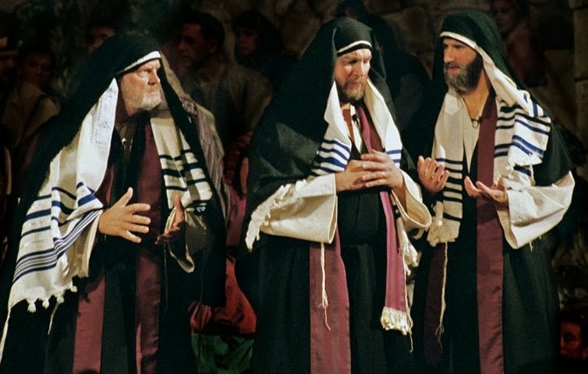
Pharisee Hypocrisy
Notes:
In Matthew 23, Jesus used the term "hypocrite" to refer to the religious leaders of his day who looked fine on the outside, but had evil intent inside.

Slide 6

Hypocrisy
"The meaning of the words, 'hypocrite' and 'hypocrisy,' as used in the Bible by our Lord Jesus Christ (primarily directed toward the 'religious' leaders of the day) implies more than a 'simple pretense' or 'acting out as a stage-player.' It embodies... a determined effort to enforce a standard of conduct upon others, which conduct the enforcer knowingly and deliberately refuses to apply to himself—hence, action born of full knowledge and evil intent."
J. Harold Greenlee and Allan R. Killen, "Hypocrisy, Hypocrite," Wycliffe Bible Dictionary
Notes:
The Wycliffe Bible Dictionary concludes…
___________
J. Harold Greenlee and Allan R. Killen, "Hypocrisy, Hypocrite," Wycliffe Bible Dictionary, eds. Charles F. Pfeiffer, Howard Vos, and John Rea; cited by http://www.bibleone.net/print_es3.html, accessed 23 July 2017.

Slide 7

Are you a hypocrite?
Notes:
The nature of deception is that the person who is deceived doesn’t know it.

Slide 8

Hypocrisy
Notes:
Hypocrisy is being deceived that you aren’t as pure on the inside as you appear on the outside.
God sees us clearly, though. He wants us to live without masks or self-deception.

Slide 9

How can you be...?
Notes:
What ways can you be the same on the inside as on the outside?

Slide 10
Background to Malachi
Background
to Malachi

Slide 11
Timeline
430
United Kingdom
1050-930
Divided Kingdom
930-722
Solitary Kingdom
722-586
Post- Exile
536-425
1050
1000
950
900
850
800
7 5 0
7 0 0
650
600
550
500
450
Exile 586-536

Slide 12
Placing the Prophets
Placing the Prophets
342
Key Dates
931
Obadiah
722
Jonah
Amos
Hosea
Isaiah
Micah
Nahum
Zephaniah
Jeremiah
Lamentations
Joel
Daniel
Haggai
Habakkuk
Ezekiel
Zechariah
Malachi
586

Slide 13
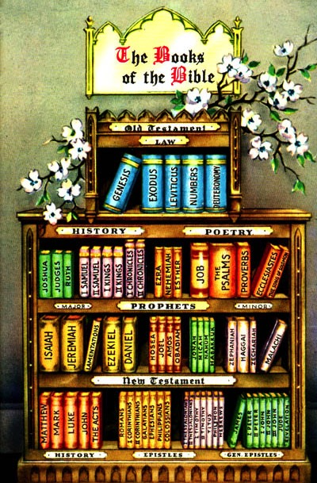
The Biblical Bookshelf

Slide 14
Chronology of Ezra-Nehemiah
HZZ
E
MEN
Zerubbabel
537-516
Zechariah
520-480
Esther
479-473
Ezra
457-444
Nehemiah
444-430
540
530
520
510
500
490
480
4
7
0
4
6
0
450
440
430
420
410
Haggai
Malachi
Notes:
Common English-183
BE-39-Malachi-14
OS-39-Malachi-49

Slide 15
Integration of the Old Testament
Walk Thru the OT
43
Leviticus
Deuteronomy
Ruth
1 Chronicles
2 Chronicles
Esther
Historical
Genesis | Exodus | Numbers | Joshua | Judges | 1 Samuel | 2 Samuel | 1 Kings | 2 Kings
Ezra | Nehemiah
1
2
3
4
5
6
7
8
9
10
11
Job
Psalms
Proverbs
Poetical
Ecclesiastes
Song of Songs
To Israel:
Hosea
Amos
To Judah:
Habakkuk
Isaiah
Jeremiah
Joel
Micah
Zephaniah
Lamentations
Ezekiel
Haggai
Malachi
Daniel
Zechariah
Prophetical
To Assyria:
Jonah
Nahum
To Edom:
Obadiah

Slide 16
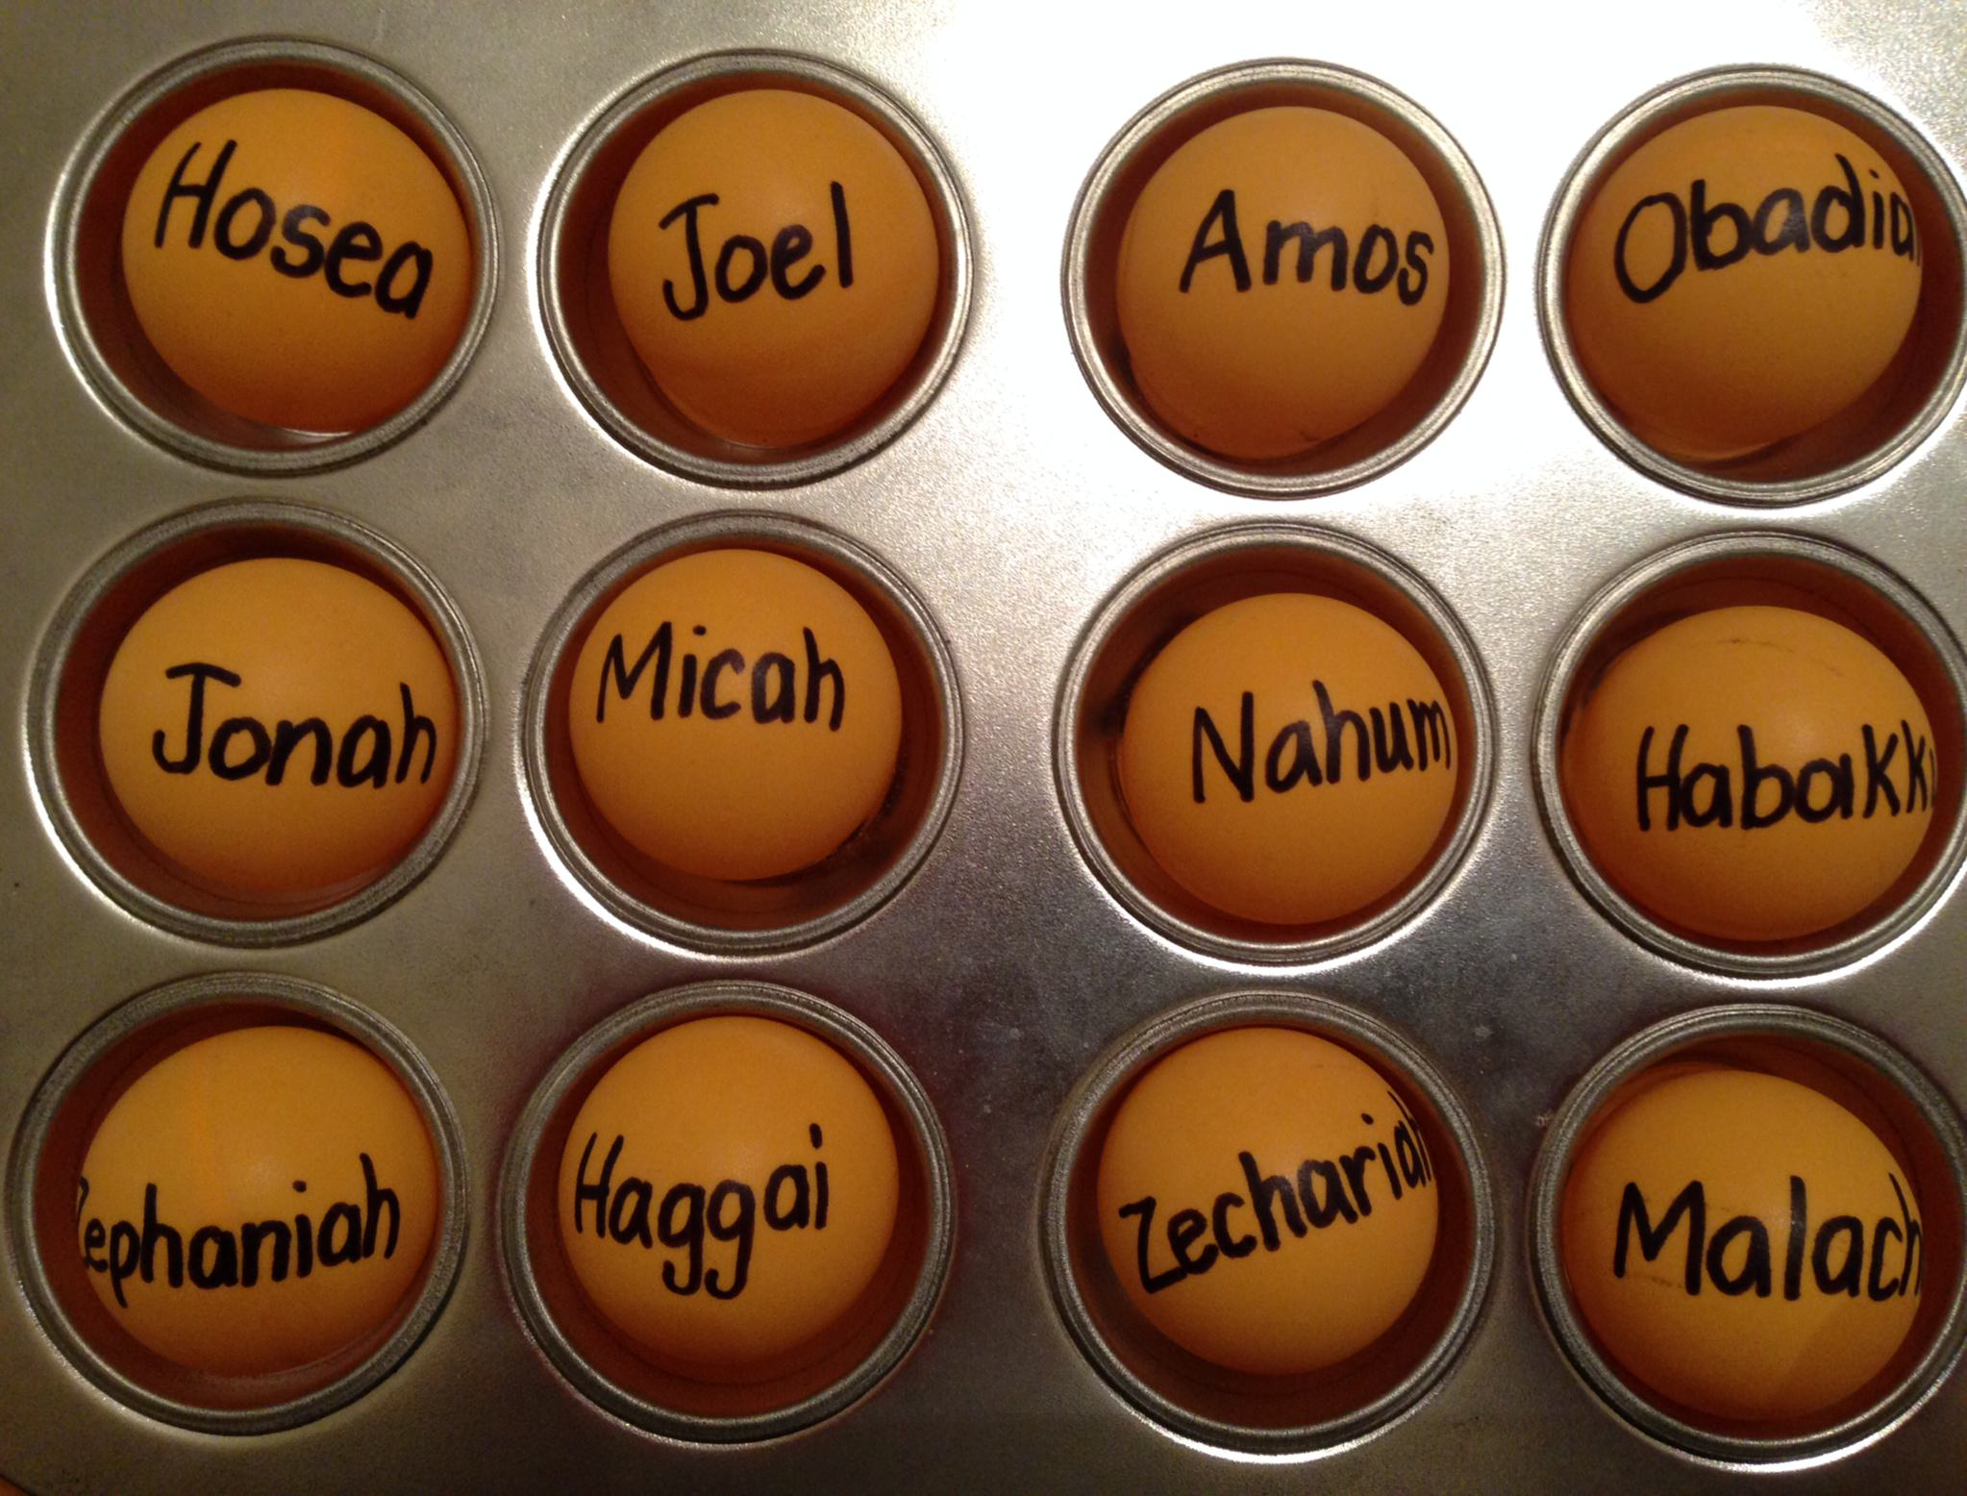
Be...
Loyal
Disciplined
Just
Humble
Caring
Generous
Patient
Amazed
Hopeful
Restored
Encouraged
Genuine
Notes:
Common English-183
BE-39-Malachi-16
OS-39-Malachi-51

Slide 17
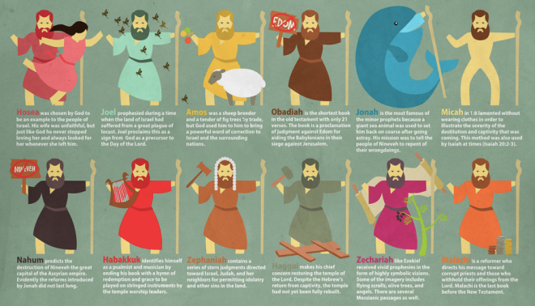
The Twelve
Courage to Confront Culture
—A Preaching Series on the Minor Prophets—

Slide 18

Sin
JUDGMENT
IDOLATRY
WRATH
D A N I E L
E Z E K I E L
PUNISHMENT
SIN
DISOBEDIENCE

Slide 19


The Journey to Exile & Back
Aleppo
Babylon
Babylonia
Jerusalem

Slide 20
Timeline of the Exile
605
70 Years
536
Ezekiel 592-572 (20)
Daniel 605-537 (68)
Jeremiah 626-586 (40)
Belshazzar 550-539 (11)
Babylonian kings
Nabonidus 555-539 (16)
Prophets
Neriglissar 559-555 (4)
Evil-Merodach 561-560 (1)
Nebuchadnezzar 605-561 (44)
Nabopolassar 630-605 (25)
650
600
550
500 BC

Slide 21


The Postexilic Era
295
296
560
The Postexilic Era
Temple work
Prophets:
Haggai
Zechariah
Malachi
605
586
539
536
520
516
483-473
444-425
Others:
Zerubbabel
Esther
Ezra
Nehemiah
Persian Kings:
Cyrus
Darius
Xerxes
Artaxerxes
Notes:
The Post-Exilic Era was actually three separate periods:
(1) Temple rebuilding led by Zerubbabel, Haggai, and Zechariah in two parts under Cyrus and Darius,
(2) The saving of the nation from destruction by Esther about 30 years later under Xerxes, and
(3) The restoration of Jerusalem’s walls and gates by Nehemiah another 70 years after that under Artaxerxes.
Zechariah 7:1 took place in King Darius's second year, in 520 BC (cf. 1:1).
_________
Common English slides-144
Common Arabic Slides-153
BE-39-Malachi-21
OS-12-Kings & Prophets Charts-24
OS-15-Ezra-36
OS-16-Nehemiah-94
OS-17-Esther-16, 75
OS-27-Daniel-340
OS-35-Haggai-43
OS-38-Zechariah-14, 46, 121
OS-39-Malachi-13, 56

Slide 22
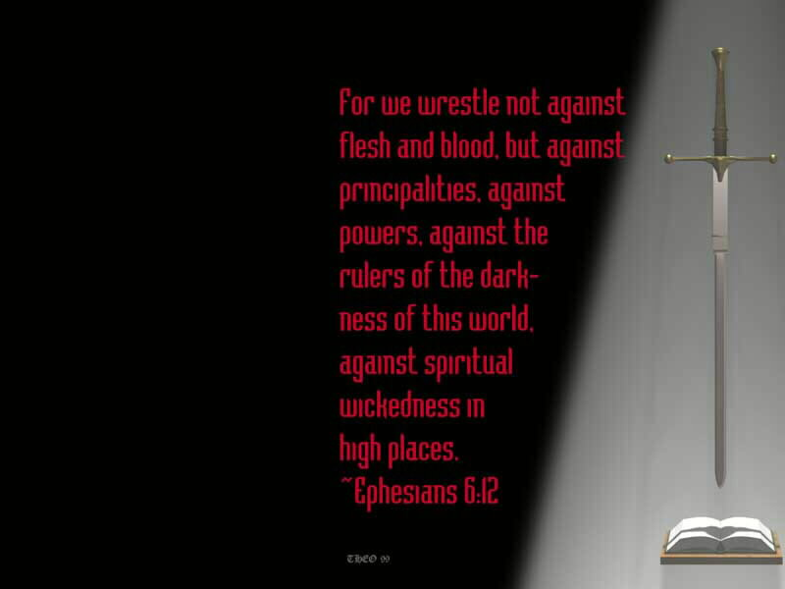
Malachi
Dr. Rick Griffith, Singapore Bible College
BibleStudyDownloads.org

Slide 23

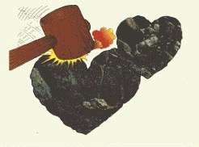
"Hearts of Stone"
Walk Through The Bible ©1989
Notes:
These Jews were three generations removed from the pioneers who braved the long trek from Babylon to the devastated land of Israel to rebuild the ancient temple amidst much opposition.
By now the temple system had been operating for a century—that's long enough for tradition to trump hearts.
As a result, these Jews had grown cold towards God and religiosity had replaced repentance.

Slide 24
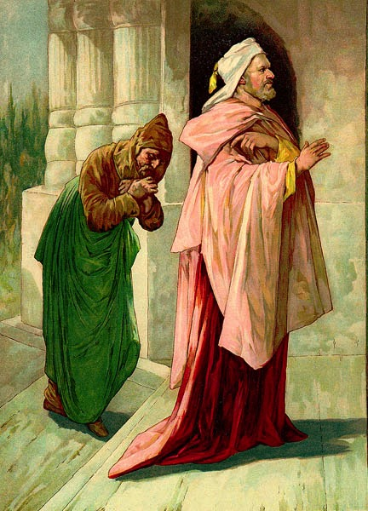
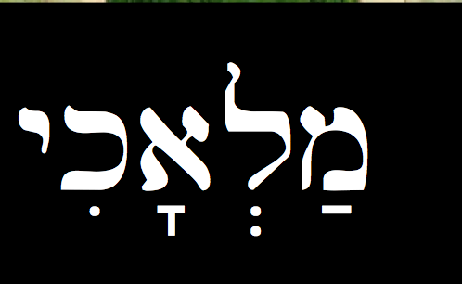
Characteristics
660
The Man Malachi
No biographical info in the Bible
Name (1:1; 3:1) could be a proper noun (Malachi) or a common noun (my messenger)
ykia'l.m;
Notes:
Into such a die situation, God raised up his spokesman called Malachi.

Slide 25
1. Date/Occasion
660
B. The Book
1. Date/Occasion
- during the Persian period
- a century after Temple in 516 BC
- postexilic prophets 100 years earlier: Haggai & Zechariah

Slide 26
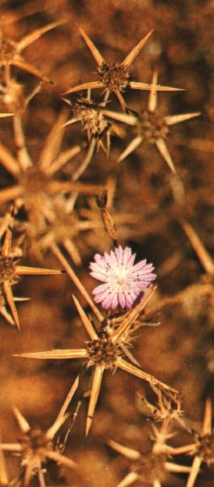
2. Historical Context
660
    -- Period of tension
    -- No greatness of God's Kingdom after the temple
    -- No sign of God's presence and blessing
    -- People did not conform to God's expectations
    -- They were not zealous for the Lord
    -- They failed to tithe
    -- They divorced their wives
    -- They married foreign women
    -- They offered maimed and diseased animals
    -- The priests accepted these sacrifices for God

Slide 27
3. Purpose
661
  To restore the people to a right relationship with God (Van Gemeren)
  To rebuke Israel's sin to exhort the people to leave their sinful lifestyle in exchange for blessing in the Kingdom (Griffith)
To rekindle the faith of a discouraged people and set forth the continuing demands of the covenant upon those who truly know God (Leggett)

Slide 28
Audience
661
Time: third or fourth generation Jews after the return from exile 100 years earlier
Their Expectations: fulfillment of the glory of the new temple under Messiah in the kingdom
Reality: disillusioned, discouraged, and doubting people experiencing poverty and drought

Slide 29
How can you be...?
two ways to avoid hypocrisy

Slide 30
Book Chart
Warning of Judgment for Hypocrisy
Chapters 1–3 |  |  | Chapter 4
Present Rebuke of Seven Sins |  |  | Future Blessing
Pollution of the Nation |  |  | Promise to the Nation
1:1–3:18 | Israel's 7 Questions | God's 7 Responses | Day of Judgment | Obey Law | Heed Elijah
1:1-5 | "How have you loved us?" | Election | 4:1-3 | 4:4 | 4:5-6
1:6–2:9 | "How have we despised Your name?" | Unacceptable sacrifices
2:10-16 | "Why do You despise our offerings?" | Divorce
2:17–3:7a | "Why aren't you just?" | Messiah will judge
3:7b-8a | "How can we repent?" | Stop robbing Me
3:8b-12 | "How have we robbed You?" | Withholding tithes
3:13-18 | "How have we blasphemed You?" | Materialistic motives
Jerusalem in ca. 425 BC
659
Warning of Judgment for Hypocrisy
Notes:
The whole book of Malachi gives this double-pronged strategy to defeat hypocrisy, focusing on the present (Mal 1-3) and future (Mal 4).

Slide 31

STOP MAKING
EXCUSES
How can you be genuine?
Malachi 1–3
Notes:
Quit finding reasons you cannot obey the LORD.

Slide 32
8 Excuses
  1:2 "How have you loved us?"
  1:6 "How have we shown contempt for your name?"
  1:7 "How have we defiled you?"
  2:14 "Why don't you accept offerings?"
  2:17 "How have we wearied him?"
  3:7 "How are we to return?"
  3:8 "How do we rob you?"
  3:13 "What have we said against you?"
Excuses! Excuses!
Notes:
Curb hypocrisy by replacing excuses with obedience (Chs. 1–3).

Slide 33
Key Word
659
343
Hypocrisy
Malachi
Notes:
Curb hypocrisy by replacing excuses with obedience (Chs. 1–3).

Slide 34
How to Curb Hypocrisy
659
Command | Our Excuse | God's Answer
Appreciate 1:1-5 | "How have you loved us?" | "I chose you but you despise me."
Notes:
Appreciate: Israel questions God's love, so he affirms that he chose Israel over its neighbor Edom so they would stop rebelling against his love (1:1-5).

Slide 35
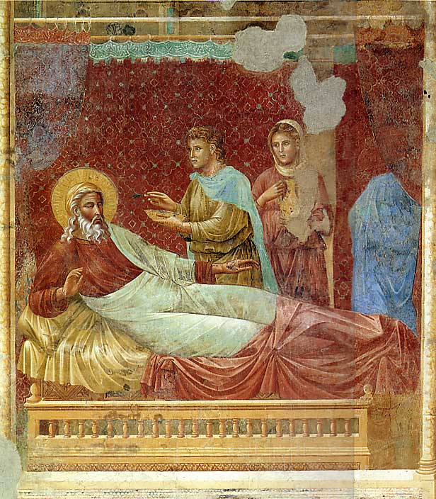
What Would You Give a King?
Malachi 1

Slide 36
Apathy
"The worst sin towards our fellow creatures is not to hate them, but to be indifferent to them"
George Bernard Shaw

Slide 37
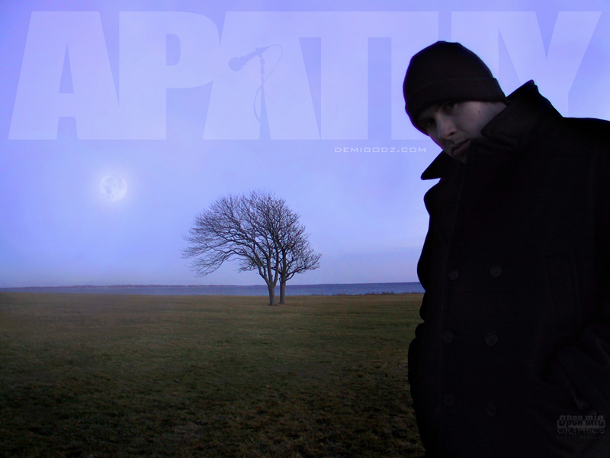
How can you worship God without apathy?

Slide 38
Chart 1:1-5
Privilege 1:1-5
1
2
3
4
5
6
Love 1:2-5
Introduction 1:1
430 B. C.
Past 1:1-5
Respond to God's Covenant Love

Slide 39
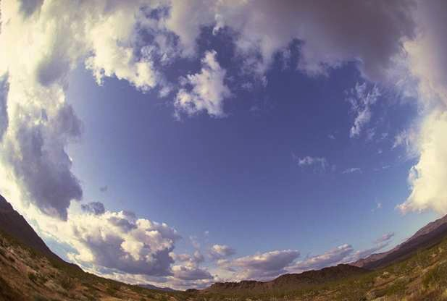
Appreciate: God chose you for blessing (1:1-5).

Slide 40
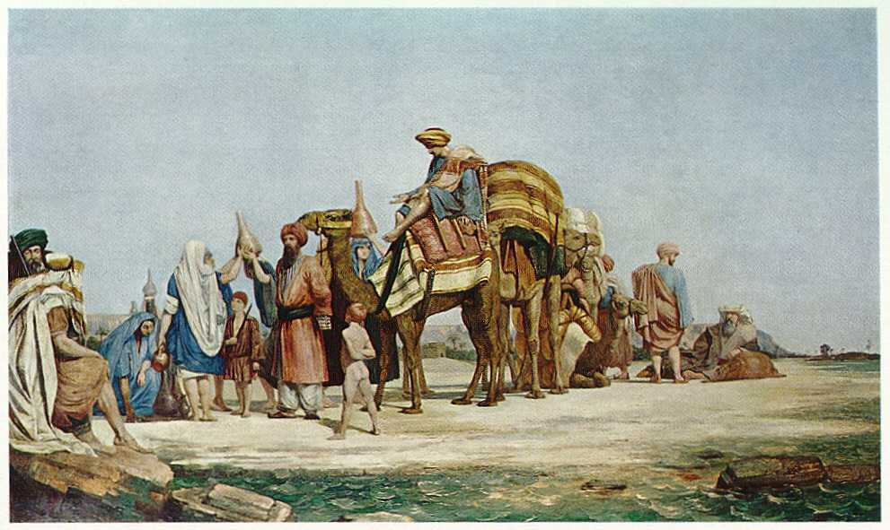
Key Questions:
Where was Edom?
Who were the Edomites?

Slide 41
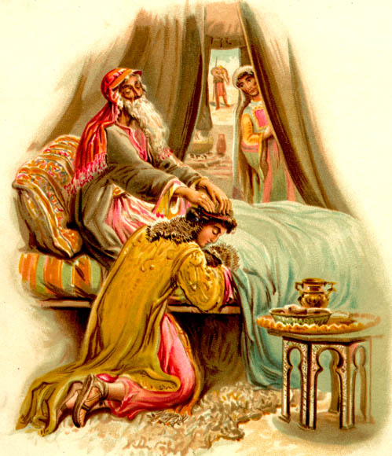
God chose Jacob over Esau
Genesis 27

Slide 42


Geography
Jacob
Israel
Esau
Edom

Slide 43

GOD CHOSE EVEN APATHETIC JEWS
Love Jacob
Hate Esau

Slide 44
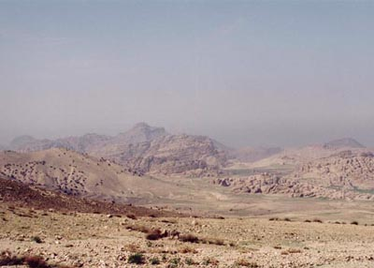
The Edomite Wasteland

Slide 45
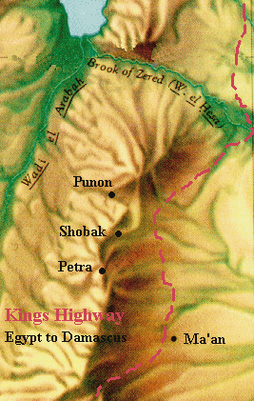
Annihilated
Israel was restored but Nabateans finished off the final remnant of Edomites in 312 BC
Idumea, or Edom,
ceased to be.
Annihilated

Slide 46
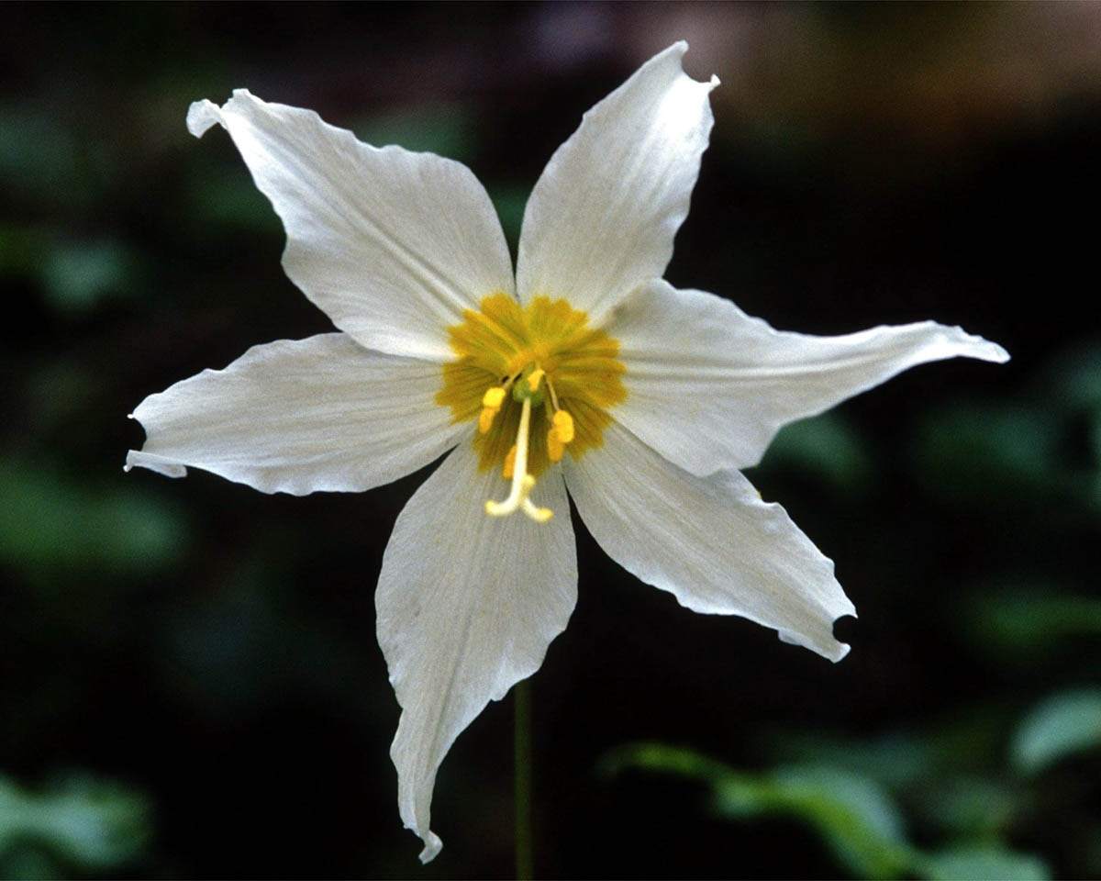
God chose us too!

Slide 47

He loves me, He loves me not…?

Slide 48

Election in Ephesians 1
³Praise be to the God and Father of our Lord Jesus Christ, who has blessed us in the heavenly realms with every spiritual blessing in Christ. ⁴For he chose us in him before the creation of the world to be holy and blameless in his sight. In love ⁵he predestined us to be adopted as his sons through Jesus Christ, in accordance with his pleasure and will--

Slide 49
Election in Ephesians 1
¹¹In him we were also chosen, having been predestined according to the plan of him who works out everything in conformity with the purpose of his will.

Slide 50
Chart 1:6-2:9
Privilege 1:1-5
Problems
1:6–3:12
1
2
3
4
5
6
Love 1:2-5
Introduction 1:1
Honor 1:6–2:9
430 BC
Past 1:1-5
Present 1:6–2:16
Respond to God's Covenant Love

Slide 51
How to Curb Hypocrisy
659
Command | Our Excuse | God's Answer
Appreciate 1:1-5 | "How have you loved us?" | "I chose you but you despise me."
Honor 1:6–2:9 | "How have we despised your name?" | "You offer lousy sacrifices."
Notes:
Honor: Israel questions despising God, so he shows that the priests offer unacceptable Levitical offerings to encourage the nation to honor God (1:6–2:9).

Slide 52
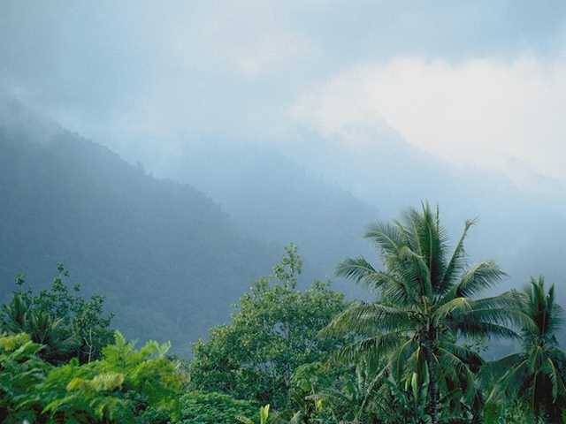
Give your best to him (1:6-14).

Slide 53
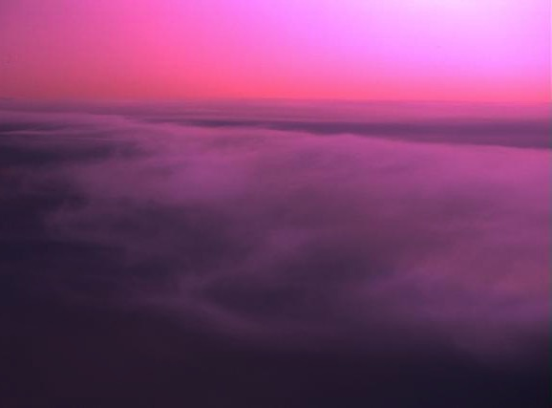
How to give God your best in worship:
Evaluate your actions during worship

Slide 54

Proper Sacrifices

Slide 55
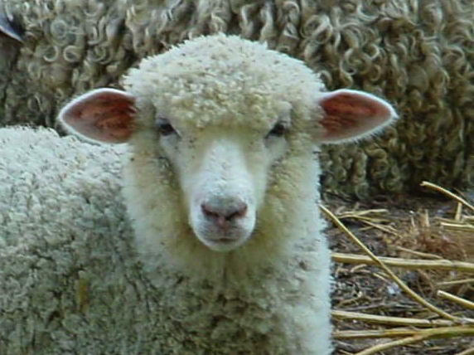
Lamb

Slide 56
Oracle Against Priests
-Oracle against Jerusalem priests for their unfaithfulness to the covenant:
They ignored the Sinai Covenant
They profaned the sacrificial system
They violated the covenant with Levi

Slide 57
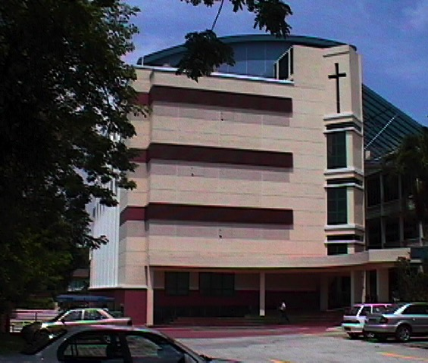
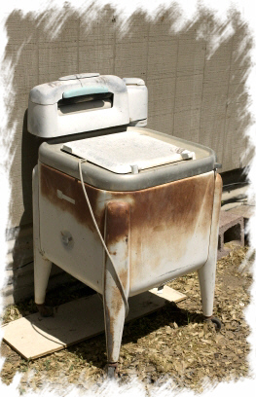
One day at SBC…
Notes:
A few years ago while eating lunch at SBC I saw an old washing machine next to our table. I asked one of our staff who was eating at my table. She said, "Oh, it wasn't here last night. Someone dropped it off for the college but none of us knows who did it. Some Christians see this a a gift to the Lord, but this often happens so people don't have to pay someone to take it away after they get a new one."

Slide 58
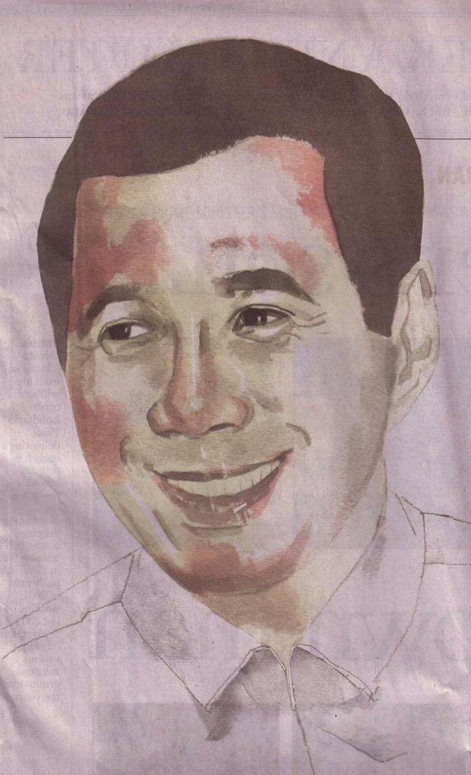

Would you give our PM junk?
Notes:
Can you imagine doing that at the Istana? "PM Lee, I appreciate so much what you are doing for the country. Here's my old washing machine as a token of my appreciation!" If we wouldn't do this even to our immediate boss, why do it to our ultimate King?

Slide 59
How to give God your best in worship:
Evaluate your actions during worship
Evaluate your attitudes during worship

Slide 60

Punctuality: "Showing high regard for others and their time"
Bill Gothard, Institute in Basic Life Principles

Slide 61
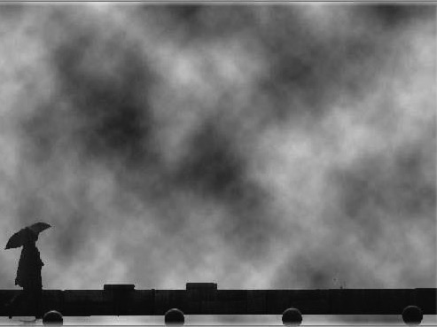
What is God saying to apathetic people today?

Slide 62

Summing Up Malachi 1…
God gave you His best…
So give Him your best!

Slide 63
Chart 2:10-16
Privilege 1:1-5
Problems
1:6–3:12
1
2
3
4
5
6
Love 1:2-5
Duty 2:10-16
Introduction 1:1
Honor 1:6–2:9
430 BC
Past 1:1-5
Present 1:6–2:16
Respond to God's Covenant Love

Slide 64
How to Curb Hypocrisy
659
Command | Our Excuse | God's Answer
Appreciate 1:1-5 | "How have you loved us?" | "I chose you but you despise me."
Honor 1:6–2:9 | "How have we despised your name?" | "You offer lousy sacrifices."
Bond 2:10-16 | "Why do you despise our offerings?" | "You divorce your wives."
Notes:
Bond: Israel questions why God rejects its offerings, so God says they divorce Jews to marry pagans rather than be faithful in their present marriage covenant (2:10-16).

Slide 65
Malachi 2:10-16
4. Third Disputation (2:10-16) Dispute about faithlessness
- You have polluted me
- How have we polluted you?
- You offered me defiled food and blemished animals
- Oracle against people of Judah re: unfaithfulness to their marriage covenant: they intermarry with pagan women or divorce their wives

Slide 66
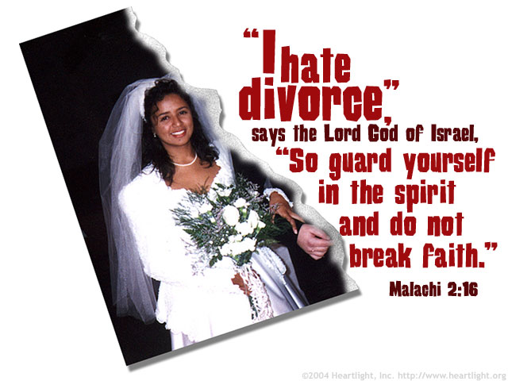
"I hate divorce!" (Malachi 2:16)

Slide 67
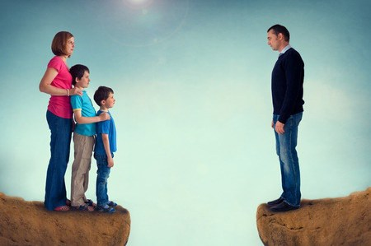
"I hate divorce!" (Malachi 2:16)

Slide 68
Chart 2:17-3:6
Privilege 1:1-5
Problems
1:6–3:12
1
2
3
4
5
6
Love 1:2-5
Duty 2:10-16
Introduction 1:1
Honor 1:6–2:9
Hope 2:17–3:6
430 BC
Past 1:1-5
Present 1:6–2:16
Future 2:17–4:6
Respond to God's Covenant Love

Slide 69
How to Curb Hypocrisy
659
Command | Our Excuse | God's Answer
Appreciate 1:1-5 | "How have you loved us?" | "I chose you but you despise me."
Honor 1:6–2:9 | "How have we despised your name?" | "You offer lousy sacrifices."
Bond 2:10-16 | "Why do you despise our offerings?" | "You divorce your wives."
Wait 2:17–3:7a | "Why aren't you just?" | "Messiah will judge—so repent."
Notes:
Wait: Israel questions God's justice, so God promises to send the Messiah to justly judge them (2:17–3:7a).

Slide 70
Key Verses
659
"You have wearied the LORD with your words. 'How have we wearied him?' you ask. By saying, 'All who do evil are good in the eyes of the LORD, and he is pleased with them' or 'Where is the God of justice?' 'See, I will send my messenger, who will prepare the way before me. Then suddenly the LORD you are seeking will come to his temple; the messenger of the covenant, whom you desire, will come,' says the LORD Almighty"
Malachi 2:17–3:1

Slide 71
Chart 3:7-12
Privilege 1:1-5
Problems
1:6–3:12
1
2
3
4
5
6
Love 1:2-5
Duty 2:10-16
Introduction 1:1
Hope 2:17–3:6
Honor 1:6–2:9
Obedience 3:7-12
430 BC
Past 1:1-5
Present 1:6–2:16
Future 2:17–4:6
Respond to God's Covenant Love

Slide 72
How to Curb Hypocrisy
659
Command | Our Excuse | God's Answer
Appreciate 1:1-5 | "How have you loved us?" | "I chose you but you despise me."
Honor 1:6–2:9 | "How have we despised your name?" | "You offer lousy sacrifices."
Bond 2:10-16 | "Why do you despise our offerings?" | "You divorce your wives."
Wait 2:17–3:7a | "Why aren't you just?" | "Messiah will judge—so repent."
Repent 3:7b-8a | "How can we repent?" | "Stop robbing me."
Notes:
Repent: Israel asks how it can repent, so God says to quit robbing Him so the people might ponder how they might be cheating God (3:7b-8a).

Slide 73
2:17–3:5
5. Fourth Disputation (2:17–3:5):
Dispute about God's Justice
- You have wearied me.
- How have we wearied you?
- By not only trying to make evil good, but by implying that I delight in evil because I do not dispense immediate justice.
- Oracle against the people of Judah re: unfaithfulness to the covenant: they are unrighteous and unjust; the Day of the Lord will judge all evildoers and them.

Slide 74
How to Curb Hypocrisy
659
Command | Our Excuse | God's Answer
Appreciate 1:1-5 | "How have you loved us?" | "I chose you but you despise me."
Honor 1:6–2:9 | "How have we despised your name?" | "You offer lousy sacrifices."
Bond 2:10-16 | "Why do you despise our offerings?" | "You divorce your wives."
Wait 2:17–3:7a | "Why aren't you just?" | "Messiah will judge—so repent."
Repent 3:7b-8a | "How can we repent?" | "Stop robbing me."
Give 3:8b-12 | "How have we robbed you?" | "No tithe—that blasphemes me."
Notes:
Give: Israel questions how it robs God, so he says they have withheld his tithes to encourage giving again so that God could bless them (3:8b-12).

Slide 75
3:6-12
6. Fifth Disputation (3:6-12)
Dispute about Repentance
- You have robbed me
- How have we robbed you?
- In unpaid tithes
- Oracle against the people of Judah re: their unfaithfulness to the covenant: they fail to provide tithes and adequate offerings to God; promise of great blessing for the faithful (upon arrival of Day of the Lord)

Slide 76
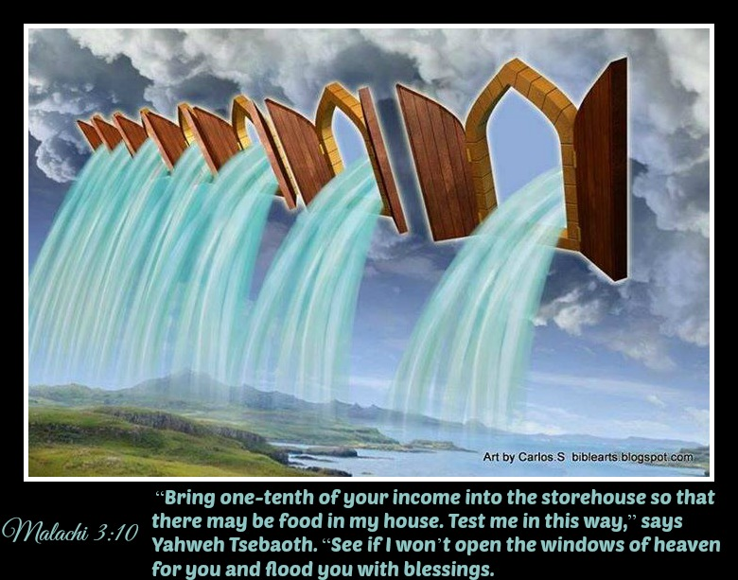
Malachi 3:10
"'Bring the whole tithe into the storehouse, that there may be food in my house. Test me in this,' says the LORD Almighty, 'and see if I will not throw open the floodgates of heaven and pour out so much blessing that you will not have room enough for it'" (Malachi 3:10 NIV).

Slide 77
Chart 3:13–4:3
Privilege 1:1-5
Problems
1:6–3:12
Promise
3:13–4:6
1
2
3
4
5
6
Love 1:2-5
Duty 2:10-16
Introduction 1:1
Hope 2:17-3:6
Reverence 3:13–4:3
Honor 1:6-2:9
Obedience 3:7-12
430 BC
Past 1:1-5
Present 1:6–2:16
Future 2:17–4:6
Respond to God's Covenant Love

Slide 78
How to Curb Hypocrisy
659
Command | Our Excuse | God's Answer
Appreciate 1:1-5 | "How have you loved us?" | "I chose you but you despise me."
Honor 1:6–2:9 | "How have we despised your name?" | "You offer lousy sacrifices."
Bond 2:10-16 | "Why do you despise our offerings?" | "You divorce your wives."
Wait 2:17–3:7a | "Why aren't you just?" | "Messiah will judge—so repent."
Repent 3:7b-8a | "How can we repent?" | "Stop robbing me."
Give 3:8b-12 | "How have we robbed you?" | "No tithe—that blasphemes me."
Respect 3:13-18 | "How have we blasphemed you?" | "Your motive to give is to get."
Notes:
Respect: Israel doubts it blasphemes God, so he shows they give only to get and promises security to the obedient to set the righteous apart from the wicked (3:13-18).

Slide 79
3:13-18
7. Sixth Disputation (3:13-18)
Dispute about Speaking Against God
- You have spoken against me.
- What have we spoken against you?
- In saying it is vain to serve me unless I bless you with immediate prosperity
- Oracle against the people of Judah regarding their unfaithfulness to the covenant: they fail to fear and honour God. It includes a warning of the coming of the Day of the LORD.

Slide 80

This church is not full of hypocrites.
There's always room for more.
Romans 3:10 "No one is righteous—not even one"
Notes:
Which of these excuses do you need to replace with obedience?

Slide 81
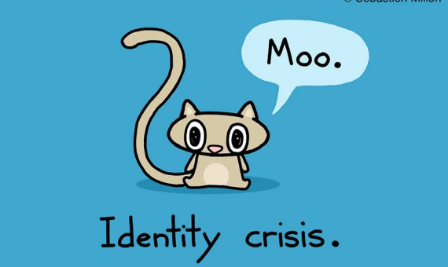
Who are you, really?
Identity crisis.

Slide 82

If it is important to you, you will find a way
If not, you'll find an excuse

Slide 83

SOMETIMES WE DON'T EVEN GET TO THE STARTING LINE

Slide 84

"I DON'T HAVE TIME!"

Slide 85

"Lord, take all my excuses..."

Slide 86
How can you be...?
two ways to avoid hypocrisy

Slide 87
STOP MAKING
EXCUSES
How can you be genuine?
Malachi 1–3
Notes:
Quit finding reasons you cannot obey the LORD.

Slide 88

II. Consider your future.
Malachi 4
Notes:
Live in light of both judgment and reward.

Slide 89
Chart 4:4-6
Privilege 1:1-5
Problems
1:6–3:12
Promise
3:13–4:6
1
2
3
4
5
6
Love 1:2-5
Duty 2:10-16
Introduction 1:1
Hope 2:17-3:6
Summary 4:4-6
Reverence 3:13–4:3
Honor 1:6-2:9
Obedience 3:7-12
430 BC
Remember the Law
1:1–2:16
Rely on the promises 2:17–4:6
Past 1:1-5
Present 1:6–2:16
Future 2:17–4:6
Respond to God's Covenant Love

Slide 90
Appendices (ch. 4)
8. Conclusion (ch. 4)
A summary of two main themes:
  the need to keep the Law of Moses (primary themes of disputations #1-3)
  and
  the need to be prepared for the coming Day of the LORD
  (primary themes of disputations #4-7)

Slide 91
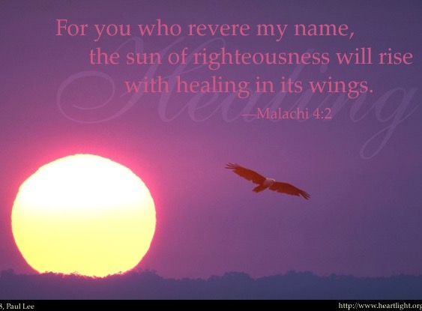
Malachi 4:2a
"But for you who fear my name,
the Sun of Righteousness will rise
with healing in his wings."
Malachi 4:2 NLT
Notes:
Fear God by realizing that the future day of the LORD (Tribulation and Millennium) will exclude the wicked but heal the righteous (4:1-3).

Slide 92
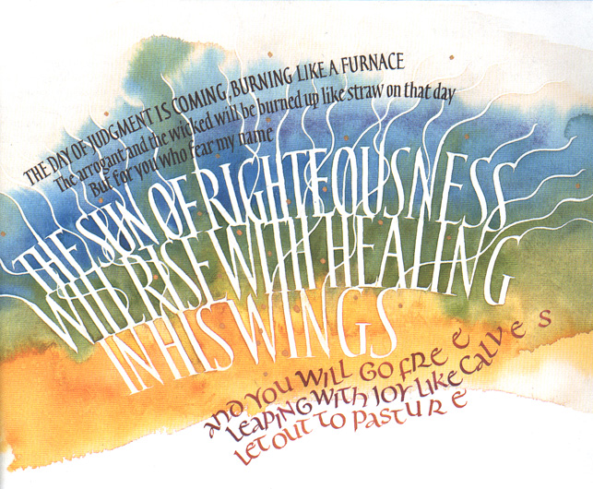
Malachi 4:2b

Slide 93
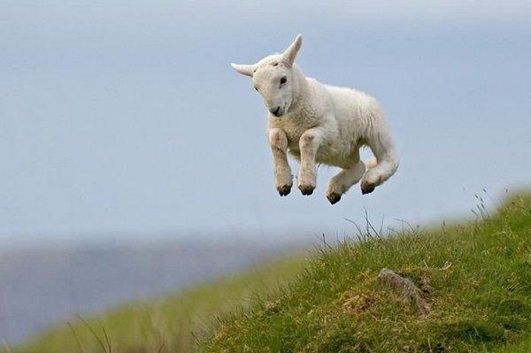
Malachi 4:2b
"…you will go free, leaping with joy like calves let out to pasture."

Slide 94
A Timeline of the Future
437
Great
White
Throne
(Rev. 20:11-14)
Rapture
(1 Thess. 4:13-18)
2nd Advent
(Zech. 14:3-5)
Day of the LORD
Church Age
Tribulation
(Zech. 14:1-2)
Millennium
(Zech. 14:6-21)
Gog & Magog
(Armageddon)
(Ezek. 38–39)
Gog and Magog
Revisited
(Rev. 20:7-10)
Notes:
94
Fear God by realizing that the future day of the LORD (Tribulation and Millennium) will exclude the wicked but heal the righteous (4:1-3).
But when will this Day of the LORD come? It has two parts: the Tribulation time of trial and the Millennium age of blessing.

Slide 95

The Big Ten (Malachi 4:4)
Notes:
“Remember to obey the Law of Moses, my servant—all the decrees and regulations that I gave him on Mount Sinai for all Israel."
Obey God’s Law (Mosaic Law for them, Christ’s law for us) since you will be judged in the day of the LORD (4:4).

Slide 96
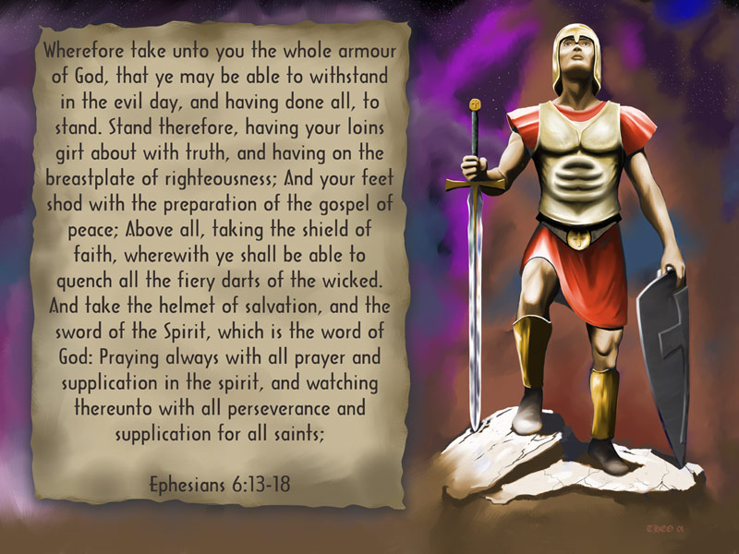
Application
Be Prepared!
Keep the faith!
Obey!
Repent!
Notes:
“Look, I am sending you the prophet Elijah before the great and dreadful day of the Lord arrives. ⁶ His preaching will turn the hearts of fathers to their children, and the hearts of children to their fathers. Otherwise I will come and strike the land with a curse" (Mal 4:5-6).
Expect an "Elijah" (first John the Baptist, then Rev 2 witness) to precede the day of the LORD to help Israel repent that they may escape the judgment (4:5-6).

Slide 97
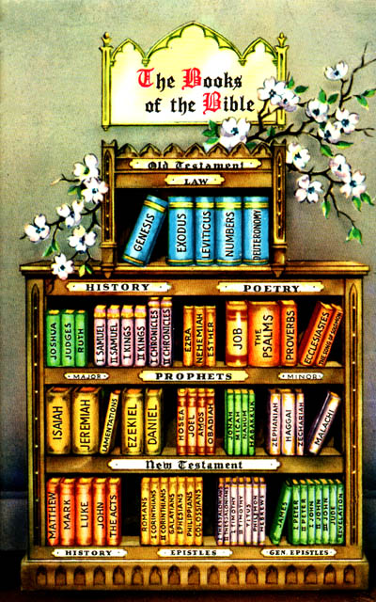

Malachi Ends
"The Twelve"
1 2 3 4 5 6 7 8 9 10 11 12

Slide 98

Malachi Kingdom Statement
343
Judah must repent of hypocrisy
(1–3) for blessing in the messianic kingdom (4).

Slide 99

Malachi
Summary Statement
659
346
The LORD rebukes the hypocrisy of postexilic Jews by answering their defensive questions so they will prepare for the coming judgment and blessing by leaving their sin and returning to Him.

Slide 100
How can you be...?
two ways to avoid hypocrisy

Slide 101

Main Idea of Malachi
Stop making excuses
consider your future.
and

Slide 102
STOP MAKING
EXCUSES
How can you be genuine?
Malachi 1–3
Notes:
Quit finding reasons you cannot obey the LORD.

Slide 103
II. Consider your future.
Malachi 4
Notes:
Live in light of both judgment and reward.

Slide 104
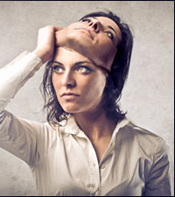
Hypocrisy
Every veil secretly desires to be lifted, except the veil of hypocrisy.
—Richard Garnett

Slide 105

STOP MAKING
EXCUSES
How can you be genuine?

Slide 106
How to Curb Hypocrisy
659
Command | Our Excuse | God's Answer
Appreciate 1:1-5 | "How have you loved us?" | "I chose you but you despise me."
Honor 1:6–2:9 | "How have we despised your name?" | "You offer lousy sacrifices."
Bond 2:10-16 | "Why do you despise our offerings?" | "You divorce your wives."
Wait 2:17–3:7a | "Why aren't you just?" | "Messiah will judge—so repent."
Repent 3:7b-8a | "How can we repent?" | "Stop robbing me."
Give 3:8b-12 | "How have we robbed you?" | "No tithe—that blasphemes me."
Respect 3:13-18 | "How have we blasphemed you?" | "Your motive to give is to get."

Slide 107
Applying Malachi
1. Christians belong to the godly seed.
2. Acceptable worship requires an acceptable lifestyle.
3. God hates divorce. Jesus agrees.
4. Christians have Jesus, who will bring judgment and purification. Repent and obey while you await his return.
Notes:
1. Appreciate 1:1-5
"How have you loved us?"
“I chose you but you despise me.”
2. Honor 1:6–2:9
"How have we despised your name?"
“You offer lousy sacrifices.”
3. Bond 2:10-16
"Why do you despise our offerings?"
“You divorce your wives.”
4. Wait 2:17–3:7a
"Why aren't you just?"
“Messiah will judge—so repent.”

Slide 108
Applying Malachi
5. God desires to bless us. Bless Him, His servants and those who are in need.
6. Do not rob God of what he has loaned you.
7. Check your motive for giving.
Notes:
5. Repent 3:7b-8a
"How can we repent?"
“Stop robbing me.”
6. Give 3:8b-12
"How have we robbed you?"
“No tithe—that blasphemes me.”
7. Respect 3:13-18
"How have we blasphemed you?"
“Your motive to give is to get.”

Slide 109
Black

Slide 110


OT Preaching link at BibleStudyDownloads.org
Get this presentation and script for free!

